Slide 2
Bài giảng: A Moment in History
Unit 2B – Giáo trình: American English File
Hệ Cao Đẳng 17C1
Trường: Cao Đẳng Lý Tự Trọng TP.HCM
Giảng viên: Nguyễn Thị Bảo Trân

Slide 3
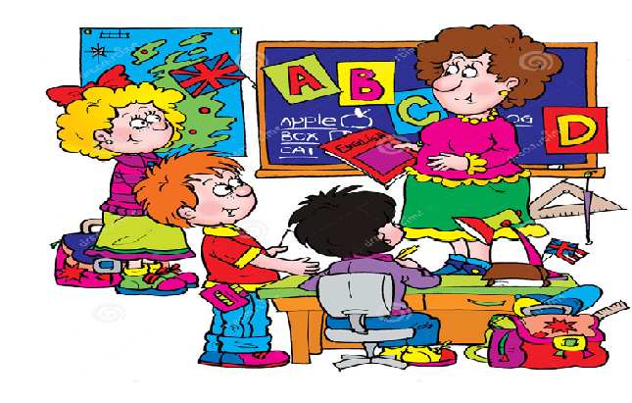
Welcome to our English class!

Slide 4

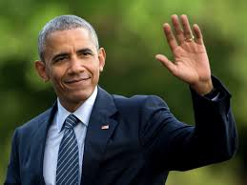

moment (n): /'məʊmənt/ very short period of time

Slide 5
Task 1: Reorder the paragraphs to make a complete text
A | I walked around the park outside the center. Although it was November, it was a warm night. The atmosphere was wonderful. When I took this photo, everybody was looking at the TV screens waiting for the election results.
B | I was watching Obama’s victory through the faces of all these people, African, Hispanic, Chinese, white. At about 11 o’clock the results were announced, and everybody went crazy. People started laughing, shouting, and crying. But when Obama made his speech they all became quiet and emotional. There was only one place to be on the planet that night – and I was there.
C | Some people were quietly holding hands and smiling – others were tense and nervous. They felt that it was their moment. Suddenly, I realized that this was a better place to be than inside.
D | On November 4th, I arrived in Chicago late in the evening. I wanted to photograph Barack Obama and his family in the convention center, but when I got there, I discovered that I didn’t have my press pass and I couldn’t go inside.

Slide 6
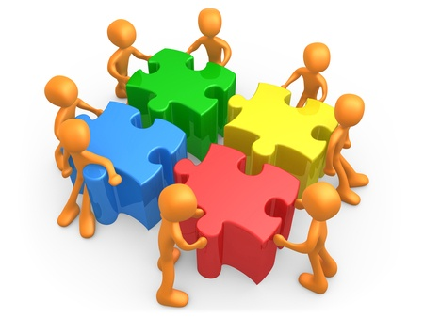
Task 1: Reorder the paragraphs to make a complete text
A MOMENT IN HISTORY
ANSWER
D – A – C – B

Slide 7
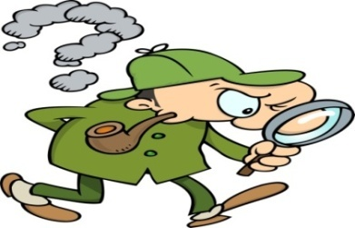
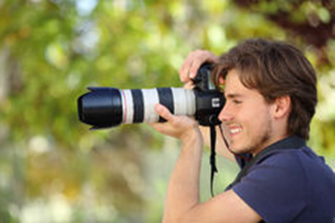
vocabulary
photograph (n) /'fəʊtəgra:f/ = photo:
a picture made by a camera
=> to photograph = take a photograph of sb/sth
=> photographer (n): /fə'tɒgrəfə(r)/
a person who takes a photograph

Slide 8
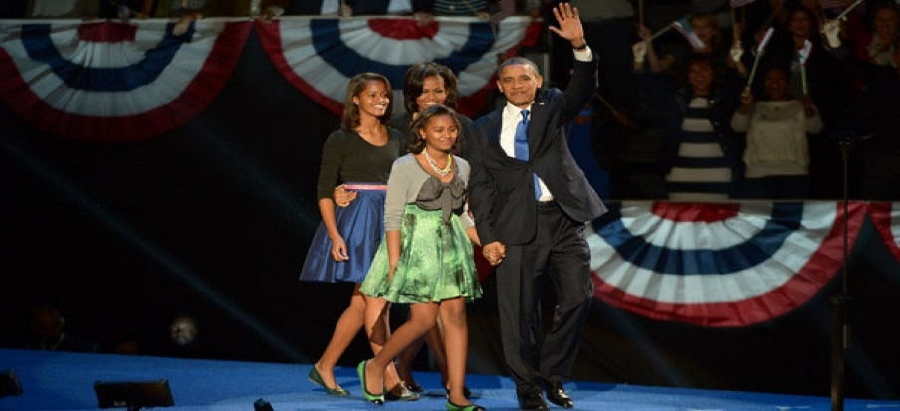
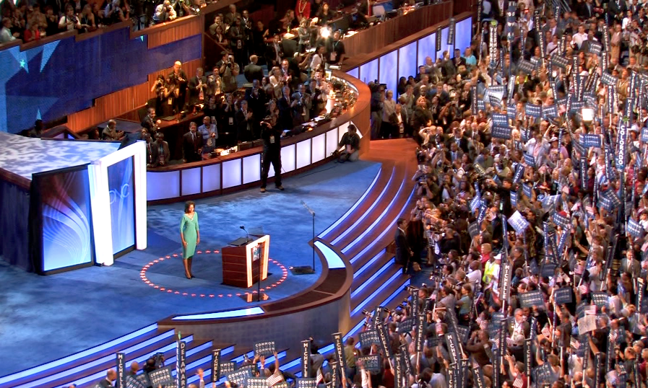
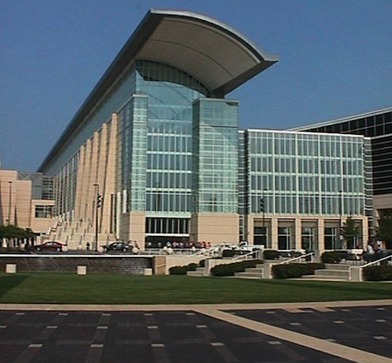
vocabulary
convention (n): /kən'venʃn/
A large meeting for special events or decisions
=> convention center (n)

